Slide 1
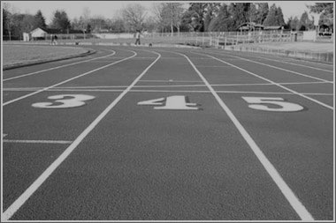
MENTOR.
MOBILIZAR.
MULTIPLICAR.
Curso 1.5.1
Correndo a Corrida Cristã

Slide 2
Hebreus 12 1 Portanto, também nós, uma vez que estamos rodeados por tão grande nuvem de testemunhas, livremo-nos de tudo o que nos atrapalha e do pecado que nos envolve, e corramos com perseverança a corrida que nos é proposta, 2 tendo os olhos fitos em Jesus, autor e consumador da nossa fé. Ele, pela alegria que lhe fora proposta, suportou a cruz, desprezando a vergonha, e assentou-se à direita do trono de Deus. ³ Pensem bem naquele que suportou tal oposição dos pecadores contra si mesmo, para que vocês não se cansem nem desanimem.
Notes:
For those who are serious about running, “Running a Race” is an excellent analogy of the Christian life because it fits, point-for-point from start to finish. Actually, from BEFORE the starting line... but we’ll get to that in a moment.
Transition:
Let’s see a short video about a man named Blaine, who is serious about running.

Slide 3
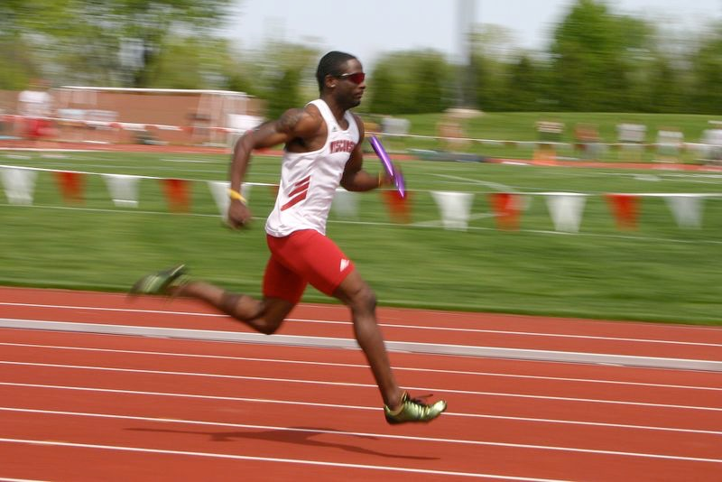
#1. Qualificação para a corrida
#2. Treinamento
para a corrida
#4. Terminando
a corrida
#3. Correndo
a corrida
Notes:
In Hebrews 12, we find that there are 4 aspects of Running a Race that are parallel to the Christian Life. They are:
(1) Qualifying for the race. Not anyone can just show up for a race and expect to be allowed to run. If you haven’t signed up, it doesn’t matter how in shape you are on race day.
(2) Training for the Race: If you are a serious runner, you can’t show up on race day and expect to perform well if you have not trained well.
(3) Running the Race: We’re not talking about a 100 yard dash. The Christian life is a marathon, so we must learn to run with “perseverance.”
(4) Finishing the Race: Paul tells us where the finish line is and how to get there. It’s all about finishing well! (Which Paul did by the way! See 2 Timothy 4:7.)

Slide 4
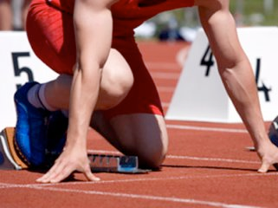
QUALIFICAÇÃO
Notes:
Before one can run in a race, he must JOIN the race. That is, he must sign up. He must be a registered runner of the race. Even if someone crosses the finish line first, he is not a winner if he was not a registered runner.
Here is an excerpt from Wikipedia about Rosie Ruiz - the apparent female winner of the Boston Marathon in 1980:
On April 21, 1980 Ruiz appeared to win the Boston Marathon's female category with a time of 2:31:56. Her time would have been the fastest female time in Boston Marathon history as well as the third-fastest female time ever recorded in any marathon.[3][4][5] However, suspicions mounted about Ruiz almost from the beginning. Men's winner Bill Rodgers, who had just won his third straight Boston Marathon, noticed that Ruiz could not recall many things that most runners know by heart, such as intervals and splits.[2] Other observers noticed that Ruiz was not panting or coated in sweat, and her thighs were much flabbier than would be expected for a world-class runner. She later released stress-test results showing her resting heart rate as 76. Most female marathoners have a resting heart rate in the 50s or lower.[1]
In addition, her time of 2:31:56 was an unusual improvement, more than 25 minutes ahead of her reported time in the New York City Marathon six months earlier. When asked by a reporter why she did not seem fatigued after the grueling race, she said, "I got up with a lot of energy this morning."[6] Some female competitors thought it was odd that, when asked what she had noticed about Wellesley, Mass., while running through it, she did not mention the students of Wellesley College, who traditionally cheer loudly for the first female runners as they pass the campus. Most seriously, no one could recall seeing her. Jacqueline Gareau was told that she was leading the race with 18 miles to go, while Patti Lyons was told she was second at the 17-mile mark. Ruiz could not have passed either of them without being seen.[5] Several spotters at checkpoints throughout the course did not remember seeing her in the first group of females. She also did not appear in any pictures or video footage.[3]
The most damning evidence against Ruiz surfaced when two Harvard students, John Faulkner and Sarah Mahoney, recalled seeing Ruiz burst out of a crowd of spectators on Commonwealth Avenue, half a mile from the finish. Not long after that, freelance photographer Susan Morrow reported meeting her on the subway during the New York Marathon and accompanying her from the subway to the race. She lost touch with Ruiz after that, but came forward when the news of Ruiz's dubious Boston win broke. According to Morrow, she met Ruiz on the subway and together they walked a distance to the finishing area, where Ruiz identified herself as an injured runner. She was escorted to a first aid station and volunteers marked her down as having completed the marathon, thus qualifying her for the Boston Marathon.
Transition: Is it possible that someone could run the entire Christian race, get to the finish line and hear, “Get away from me, you evildoer, for I never knew you!” Let’s take a look at Matthew 7:

Slide 5
Mateus 7:21-23
21 “Nem todo aquele que me diz: ‘Senhor, Senhor’, entrará no Reino dos céus, mas apenas aquele que faz a vontade de meu Pai que está nos céus. 22 Muitos me dirão naquele dia: ‘Senhor, Senhor, não profetizamos em teu nome? Em teu nome não expulsamos demônios e não realizamos muitos milagres?’ 23 Então eu lhes direi claramente: Nunca os conheci. Afastem-se de mim vocês, que praticam o mal!
Notes:
So there are some who think they belong to God, but do not. They even do religious things, but they are not saved! Imagine their surprise after crossing the finish line, to find that they were never qualified to run the race!
Transition: So, how do we get qualified anyway?

Slide 6
Hebreus 12 1 Portanto, também nós, uma vez que estamos rodeados por tão grande nuvem de testemunhas, livremo-nos de tudo o que nos atrapalha e do pecado que nos envolve, e corramos com perseverança a corrida que nos é proposta, 2 tendo os olhos fitos em Jesus, autor e consumador da nossa fé. Ele, pela alegria que lhe fora proposta, suportou a cruz, desprezando a vergonha, e assentou-se à direita do trono de Deus. ³ Pensem bem naquele que suportou tal oposição dos pecadores contra si mesmo, para que vocês não se cansem nem desanimem.
Notes:
For those who are serious about running, “Running a Race” is an excellent analogy of the Christian life because it fits, point-for-point from start to finish. Actually, from BEFORE the starting line... but we’ll get to that in a moment.
Transition:
Let’s see a short video about a man named Blaine, who is serious about running.

Slide 7
Nuvem de Testemunhas
Moisés
David
Abel
Isaac
Noé
Barak
Jacó
Raabe
Sansão
Enoque
Abraão
Jephthah
Samuel
José
Gideão
Notes:
In Hebrews 11, we find the “Great Hall of Faith.” Name after name of people who lived out their faith.... ran their race! The great cloud of witnesses is the collective group of those who have gone before...those who have already run their race.
Transition:
But what do they all have in common?

Slide 8
Hebreus 11
Todos correram a corrida
Como é que qualifica?
“Por fé . . .”
Notes:
They all ran the race!!!
Transition:
Let’s have a demonstration right now. I need a couple of volunteers.

Slide 9
Hebreus 11
6 sem fé é impossível agradar a Deus.
Notes:
[read]
But what kind of faith? What does faith actually mean?
Transition: Because the Bible talks about two very different kinds of faith...

Slide 10
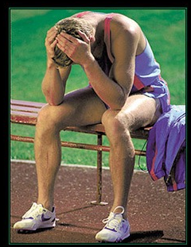
2 Tipos de Fé
Fé simples
Fé Sálvica

Slide 11
Tiago 2:14-24
Notes:
[read and explain]

Slide 12
Fé Simples vs. Fé Sálvica
Fé simples
Fé Sálvica
Produz nada
Produz boas obras
Afeta somente o intelecto
Afeita o intelecto e a vontade
Notes:
Simple Faith:
(1) A Simple Faith produces nothing. (v. 16 - “does nothing”)
(2) Affects the Intellect alone. (v. 19 - even the demons have intellectual faith)
Saving Faith:
(1) Produces good works. (v. 18 - “I will show you my faith by my deeds.”)
(2) Affects intellect and will. (v. 17 - “faith without works is dead.”

Slide 13
Hebreus 10:38-39
Notes:
[read]

Slide 14
Fé Simples vs. Fé Sálvica
Fé simples
Fé Sálvica
Produz nada
Produz boas obras
Afeta somente o intelecto
Afeita o intelecto e a vontade
Falha cada vez mais.
Persevera
Notes:
Simple Faith:
(1) A Simple Faith produces nothing. (v. 16 - “does nothing”)
(2) Affects the Intellect alone. (v. 19 - even the demons have intellectual faith)
Saving Faith:
(1) Produces good works. (v. 18 - “I will show you my faith by my deeds.”)
(2) Affects intellect and will. (v. 17 - “faith without works is dead.”

Slide 15
Eu confio em qual tipo de fé?
Será que sou um filho de Deus
verdadeiro?
Eu estou dependendo de mais
alguém?
Será que minha fé representa uma mudança de vida verdadeira?
-Vou fazer o que sobre isto?
Notes:
[Bring them to conclusion with these questions. We want to make sure that we do not start training non-racers. They must be genuinely saved or we are doing them a disservice by letting them think they are saved.]

Slide 17
#1. Qualificação para a corrida
#2. Treinamento
para a corrida
Notes:
In Hebrews 12, we find that there are 4 aspects of Running a Race that are parallel to the Christian Life. They are:
(1) Qualifying for the race. Not anyone can just show up for a race and expect to be allowed to run. If you haven’t signed up, it doesn’t matter how in shape you are on race day.
(2) Training for the Race: If you are a serious runner, you can’t show up on race day and expect to perform well if you have not trained well.
(3) Running the Race: We’re not talking about a 100 yard dash. The Christian life is a marathon, so we must learn to run with “perseverance.”
(4) Finishing the Race: Paul tells us where the finish line is and how to get there. It’s all about finishing well! (Which Paul did by the way! See 2 Timothy 4:7.)

Slide 18
TREINAMENTO

Slide 19
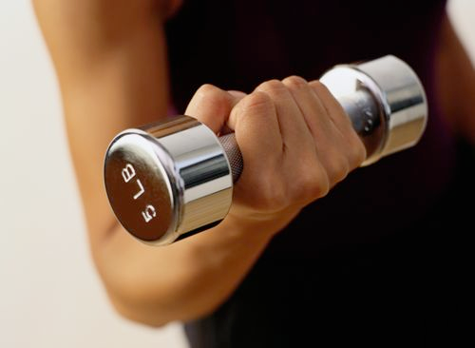
Dois Componentes essenciais de treino
1.
Disciplina pelo tecnico/treinador.
2.
Auto-Disciplina

Slide 20
Hebreus 12:4-11

Slide 21
TREINAMENTO
Nosso treinador é Deus. (Nosso Pai Celestial)
O alvo é santidade. v.10
É muito difícil. v.11
O dor é no momento. v.11
Produz justiça. v.11
Notes:
(1) God is our trainer. He puts obstacles (trials) in our way to strengthen us, not to harm us. So when we suffer for things that are not our fault, we know that God has designed those “exercises” to develop our spiritual strength.
(2) The goal is holiness. Literally, to share in HIS holiness. How cool is that!??! We should now begin to see how trials move us more and more towards godliness (or Christlikeness.)
(3) It is painfully hard. Expect pain. It’s a part of working out. But you’ll love the results!
(4) The pain is temporary. As humans, we get caught up in the present. When we are in the midst of a trial, it is helpful to know there is an end in sight.
(5) It produces a harvest of righteousness. Paul breaks out of the racing analogy for a moment, and uses a farming one. Training is like planting season. It’s hard work, and we see nothing for it at the time. But a day will come when we see the harvest, which will reap 100 times more than was sewn.

Slide 22
Dois Componentes essenciais de treino
1.
Disciplina pelo tecnico/treinador.
2.
Auto-Disciplina

Slide 23
Hebreus 12:12-13
Notes:
So what? We look for our weaknesses and create an exercise to strengthen that area.

Slide 24
Os 2 Passos de Auto-Disciplina
1 - Descobre sua fraqueza
2 - Desenvolve um exercício
de treino

Slide 25
Exemplos
Fraqueza
Exemplo de um exercisio para ajudar
Paciencia
escolhe a fila mais longa no supermercado
Amor
Faz algo simpatico por alguém que você não gosta
Generosidade
Paga pelas compras de alguem
Egoismo
Deixe alguém na sua frente quando está se servindo
Auto-controle
Faz um orçamento e o segue
Preguiça
Ajuda alguém voluntariamente

Slide 27
#1. Qualificação para a corrida
#2. Treinamento
para a corrida
#3. Correndo
a corrida
Notes:
In Hebrews 12, we find that there are 4 aspects of Running a Race that are parallel to the Christian Life. They are:
(1) Qualifying for the race. Not anyone can just show up for a race and expect to be allowed to run. If you haven’t signed up, it doesn’t matter how in shape you are on race day.
(2) Training for the Race: If you are a serious runner, you can’t show up on race day and expect to perform well if you have not trained well.
(3) Running the Race: We’re not talking about a 100 yard dash. The Christian life is a marathon, so we must learn to run with “perseverance.”
(4) Finishing the Race: Paul tells us where the finish line is and how to get there. It’s all about finishing well! (Which Paul did by the way! See 2 Timothy 4:7.)

Slide 28
Correndo

Slide 29
Hebreus 12:1

Slide 30
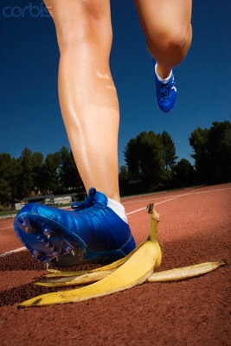
Correndo a corrida
(1) Tirar fora . . .
(a) pecado
(b) peso
Notes:
The writer of Hebrews makes an important distinction between sin and weight.
(1) Sin - In this context, sin is defined as a direct violation of a God-given command or order. In keeping with the racing analogy, it is sin that entangles us. It trips us up. A few examples would be... pornography, dishonesty, drunkenness, etc. These things will entangle us if we participate in them. God has already forbid such things clearly in His Word.
(2) Weight - Weight is different than sin. It’s when we allow things that are not necessarily sin in and of themselves, to hinder our spiritual progress. An example could be watching TV. Sure, if we are watching something sinful, this would lie under category #1, but let’s assume the the believer is watching wholesome entertainment. Can that become a weight? Sure it can... if we watch too much, or if it becomes too high a priority. Other examples could be sports, recreation, work, etc. If they slow us down, they are weights. It is in this sense we see that non-sinful activities actually become sinful.
In the illustration of a race, a sin might be something that is against the rules in a race, but a weight may be “legal” but not beneficial. As far as I know, it is not against the rules to wear moon boots (winter boots) in a marathon. But yet, I have never seen anyone wear them. Why? It’s weight. I’ve never seen anyone run a marathon in jeans, or carrying a boom box. Again, not against the rules. but they are weight.

Slide 31
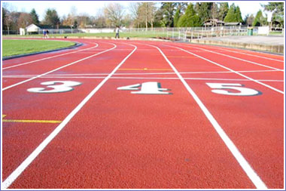
Actividade: Corrida
Notes:
[Before the race]
Like before, make sure you have an aisle or some visible area for people to run a race. Ask for two volunteer to run a race. Try to pick an obvious winner and loser. Have them run the race. Now, ask them to re-run the race, asking the audience who they think is going to win. But before they start, you ask one of them to carry some extra weight. I have used snorkeling fins and scuba gear. Once I used a backpack full of books. Another time, I tied string around one runner’s legs to give the image of being “entangled” by sin. In any case, make sure the racers are safe from any physical danger.
Transition: So was it against the rules to carry X (or wear X)? No! But is it beneficial? [If time permits, one could lead a brief discussion over 1 Corinthians 6:12-13, and 10:23-33, which also deals with this idea, where something is permissible, but not wise in a given context. Make sure they grasp this concept.]

Slide 32
Perguntas pra me avaliar e me faz pensar:
Será que tenho hábitos pecaminosos?
Eu tenho atividade desnecessário que tira muito do meu tempo?
Eu tenho amizades que me baixa espiritualmente?
Eu tenho hábitos que impede minha caminhada com Deus?
Eu tenho alvos que me impede espiritualmente?
Eu tenho medos que me impede de obedecer a Deus?
PECADO
ou
PESO

Slide 33
Correndo a corrida
(1) Tirar fora . . .
(a) pecado
(b) peso
(2) Corre com perseveranca
Notes:
The writer of Hebrews makes an important distinction between sin and weight.
(1) Sin - In this context, sin is defined as a direct violation of a God-given command or order. In keeping with the racing analogy, it is sin that entangles us. It trips us up. A few examples would be... pornography, dishonesty, drunkenness, etc. These things will entangle us if we participate in them. God has already forbid such things clearly in His Word.
(2) Weight - Weight is different than sin. It’s when we allow things that are not necessarily sin in and of themselves, to hinder our spiritual progress. An example could be watching TV. Sure, if we are watching something sinful, this would lie under category #1, but let’s assume the the believer is watching wholesome entertainment. Can that become a weight? Sure it can... if we watch too much, or if it becomes too high a priority. Other examples could be sports, recreation, work, etc. If they slow us down, they are weights. It is in this sense we see that non-sinful activities actually become sinful.
In the illustration of a race, a sin might be something that is against the rules in a race, but a weight may be “legal” but not beneficial. As far as I know, it is not against the rules to wear moon boots (winter boots) in a marathon. But yet, I have never seen anyone wear them. Why? It’s weight. I’ve never seen anyone run a marathon in jeans, or carrying a boom box. Again, not against the rules. but they are weight.

Slide 34
Correndo a corrida
(1) Tirar fora . . .
(a) pecado
(b) peso
(2) Corre com perseveranca
(3) Continuar no caminho. Devemos evitar atalhos e desvios
Notes:
The writer of Hebrews makes an important distinction between sin and weight.
(1) Sin - In this context, sin is defined as a direct violation of a God-given command or order. In keeping with the racing analogy, it is sin that entangles us. It trips us up. A few examples would be... pornography, dishonesty, drunkenness, etc. These things will entangle us if we participate in them. God has already forbid such things clearly in His Word.
(2) Weight - Weight is different than sin. It’s when we allow things that are not necessarily sin in and of themselves, to hinder our spiritual progress. An example could be watching TV. Sure, if we are watching something sinful, this would lie under category #1, but let’s assume the the believer is watching wholesome entertainment. Can that become a weight? Sure it can... if we watch too much, or if it becomes too high a priority. Other examples could be sports, recreation, work, etc. If they slow us down, they are weights. It is in this sense we see that non-sinful activities actually become sinful.
In the illustration of a race, a sin might be something that is against the rules in a race, but a weight may be “legal” but not beneficial. As far as I know, it is not against the rules to wear moon boots (winter boots) in a marathon. But yet, I have never seen anyone wear them. Why? It’s weight. I’ve never seen anyone run a marathon in jeans, or carrying a boom box. Again, not against the rules. but they are weight.

Slide 36
#1. Qualificação para a corrida
#2. Treinamento
para a corrida
#4. Terminando
a corrida
#3. Correndo
a corrida
Notes:
In Hebrews 12, we find that there are 4 aspects of Running a Race that are parallel to the Christian Life. They are:
(1) Qualifying for the race. Not anyone can just show up for a race and expect to be allowed to run. If you haven’t signed up, it doesn’t matter how in shape you are on race day.
(2) Training for the Race: If you are a serious runner, you can’t show up on race day and expect to perform well if you have not trained well.
(3) Running the Race: We’re not talking about a 100 yard dash. The Christian life is a marathon, so we must learn to run with “perseverance.”
(4) Finishing the Race: Paul tells us where the finish line is and how to get there. It’s all about finishing well! (Which Paul did by the way! See 2 Timothy 4:7.)

Slide 37
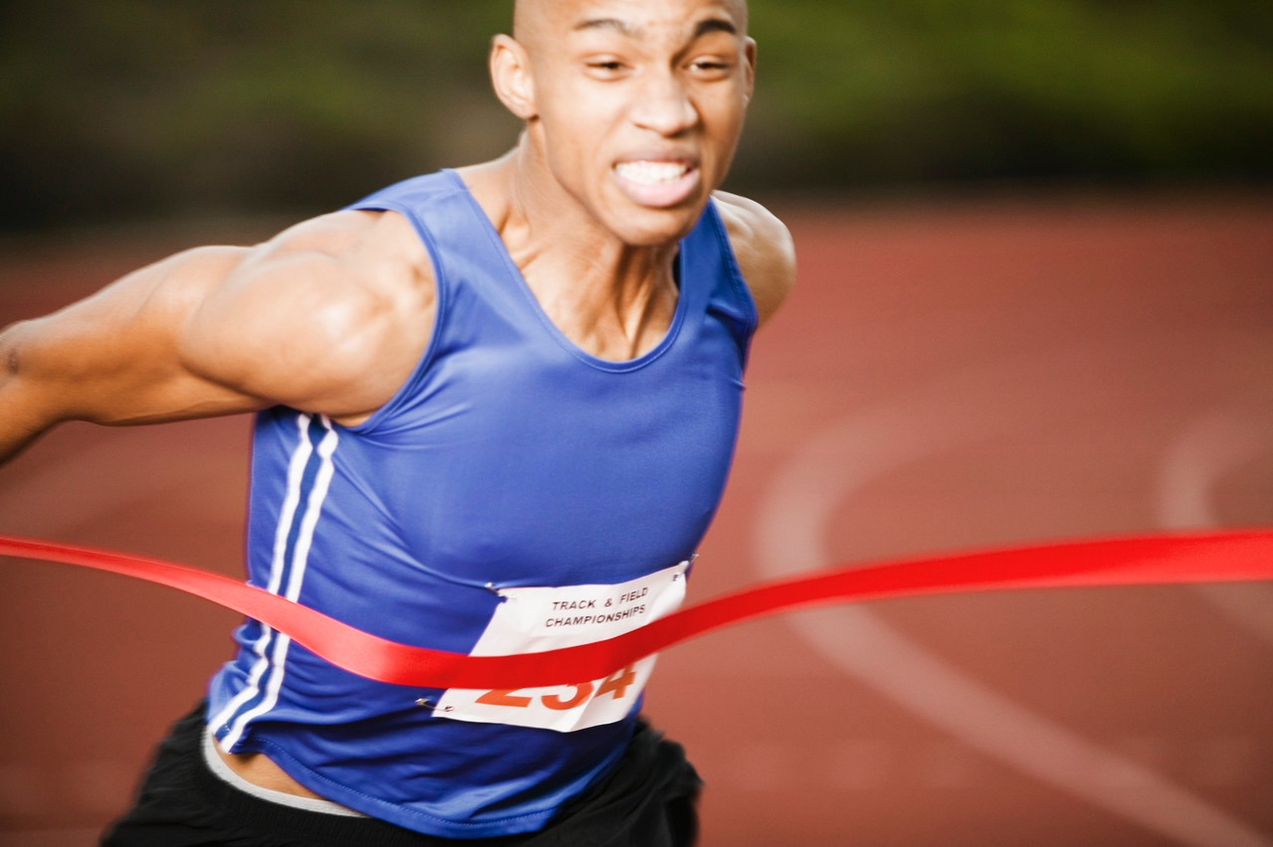
Terminando a Corrida
Notes:
What’s the goal of the race? Where are we actually headed?

Slide 38
Hebreus 12 1 Portanto, também nós, uma vez que estamos rodeados por tão grande nuvem de testemunhas, livremo-nos de tudo o que nos atrapalha e do pecado que nos envolve, e corramos com perseverança a corrida que nos é proposta, 2 tendo os olhos fitos em Jesus, autor e consumador da nossa fé. Ele, pela alegria que lhe fora proposta, suportou a cruz, desprezando a vergonha, e assentou-se à direita do trono de Deus. ³ Pensem bem naquele que suportou tal oposição dos pecadores contra si mesmo, para que vocês não se cansem nem desanimem.
Notes:
For those who are serious about running, “Running a Race” is an excellent analogy of the Christian life because it fits, point-for-point from start to finish. Actually, from BEFORE the starting line... but we’ll get to that in a moment.
Transition:
Let’s see a short video about a man named Blaine, who is serious about running.

Slide 39
Terminando a Corrida
Alvo = Ser como Cristo
Notes:
The goal is to be like Jesus. If we are not like Him, we aren’t there yet. Since we are still sinners, we are striving to be like Christ. But, how do we overcome sin? How do we overcome something that is a part of our nature?
Transition:
We need to first understand the process of overcoming sin, which is found in Ephesians 4:

Slide 40
Ciclo de Comportamento
Caráter
constroem
controla
Habitos
Pensamentos
determinam
viram
Ações
Notes:
(1) Character controls our thoughts. Let’s say a godly man and an ungodly man are walking down the same beach. A physically attractive girl walks by in an immodest bathing suit. The godly man turns his eyes away and thinks, “Poor girl has no idea what she’s doing. She will only attract shallow men dressing like that. She might never know the true joy of intimacy like I have with my wife.” The ungodly man peeks through the corner of his sunglasses to get an extra long glance and thinks, “Man, she is hot! I wonder if she’s got a boyfriend!” Our character will shape our thoughts in the time of temptation.
(2) Thoughts determine actions. The godly man’s thoughts will lead him to look away and even focus his thoughts on his wife. The ungodly man will probably pursue his temptation, whether it is her or any other pretty girl he comes across.
(3) Actions become habits. The godly man will form habits that keep him from being around temptation. The ungodly man will seek out opportunities where he can see more improperly dressed women.
(4) Habits build character. Over time, our habits will mold us into who we are. The godly man will continue to grow in love for his wife. The ungodly man will hop in and out of shallow relationships, never knowing the true meaning of intimacy.
But where do we start? How do we make this cycle work FOR us instead of AGAINST us?
Transition:
Let’s think about that together for a moment.

Slide 41
Ciclo de Comportamento
Caráter
Caráter
constroem
controla
Habitos
Pensamentos
determinam
viram
Ações
Notes:
(1) Character controls our thoughts. Let’s say a godly man and an ungodly man are walking down the same beach. A physically attractive girl walks by in an immodest bathing suit. The godly man turns his eyes away and thinks, “Poor girl has no idea what she’s doing. She will only attract shallow men dressing like that. She might never know the true joy of intimacy like I have with my wife.” The ungodly man peeks through the corner of his sunglasses to get an extra long glance and thinks, “Man, she is hot! I wonder if she’s got a boyfriend!” Our character will shape our thoughts in the time of temptation.
(2) Thoughts determine actions. The godly man’s thoughts will lead him to look away and even focus his thoughts on his wife. The ungodly man will probably pursue his temptation, whether it is her or any other pretty girl he comes across.
(3) Actions become habits. The godly man will form habits that keep him from being around temptation. The ungodly man will seek out opportunities where he can see more improperly dressed women.
(4) Habits build character. Over time, our habits will mold us into who we are. The godly man will continue to grow in love for his wife. The ungodly man will hop in and out of shallow relationships, never knowing the true meaning of intimacy.
But where do we start? How do we make this cycle work FOR us instead of AGAINST us?
Transition:
Let’s think about that together for a moment.

Slide 42
Ciclo de Comportamento
Caráter
constroem
controla
Habitos
Pensamentos
determinam
viram
Ações
Notes:
(1) Character controls our thoughts. Let’s say a godly man and an ungodly man are walking down the same beach. A physically attractive girl walks by in an immodest bathing suit. The godly man turns his eyes away and thinks, “Poor girl has no idea what she’s doing. She will only attract shallow men dressing like that. She might never know the true joy of intimacy like I have with my wife.” The ungodly man peeks through the corner of his sunglasses to get an extra long glance and thinks, “Man, she is hot! I wonder if she’s got a boyfriend!” Our character will shape our thoughts in the time of temptation.
(2) Thoughts determine actions. The godly man’s thoughts will lead him to look away and even focus his thoughts on his wife. The ungodly man will probably pursue his temptation, whether it is her or any other pretty girl he comes across.
(3) Actions become habits. The godly man will form habits that keep him from being around temptation. The ungodly man will seek out opportunities where he can see more improperly dressed women.
(4) Habits build character. Over time, our habits will mold us into who we are. The godly man will continue to grow in love for his wife. The ungodly man will hop in and out of shallow relationships, never knowing the true meaning of intimacy.
But where do we start? How do we make this cycle work FOR us instead of AGAINST us?
Transition:
Let’s think about that together for a moment.

Slide 43
Ciclo de Comportamento
Caráter
constroem
controla
Habitos
Pensamentos
determinam
viram
Ações
Ações
Notes:
(1) Character controls our thoughts. Let’s say a godly man and an ungodly man are walking down the same beach. A physically attractive girl walks by in an immodest bathing suit. The godly man turns his eyes away and thinks, “Poor girl has no idea what she’s doing. She will only attract shallow men dressing like that. She might never know the true joy of intimacy like I have with my wife.” The ungodly man peeks through the corner of his sunglasses to get an extra long glance and thinks, “Man, she is hot! I wonder if she’s got a boyfriend!” Our character will shape our thoughts in the time of temptation.
(2) Thoughts determine actions. The godly man’s thoughts will lead him to look away and even focus his thoughts on his wife. The ungodly man will probably pursue his temptation, whether it is her or any other pretty girl he comes across.
(3) Actions become habits. The godly man will form habits that keep him from being around temptation. The ungodly man will seek out opportunities where he can see more improperly dressed women.
(4) Habits build character. Over time, our habits will mold us into who we are. The godly man will continue to grow in love for his wife. The ungodly man will hop in and out of shallow relationships, never knowing the true meaning of intimacy.
But where do we start? How do we make this cycle work FOR us instead of AGAINST us?
Transition:
Let’s think about that together for a moment.

Slide 44
Ciclo de Comportamento
Caráter
constroem
controla
Habitos
Pensamentos
determinam
viram
Ações
Notes:
(1) Character controls our thoughts. Let’s say a godly man and an ungodly man are walking down the same beach. A physically attractive girl walks by in an immodest bathing suit. The godly man turns his eyes away and thinks, “Poor girl has no idea what she’s doing. She will only attract shallow men dressing like that. She might never know the true joy of intimacy like I have with my wife.” The ungodly man peeks through the corner of his sunglasses to get an extra long glance and thinks, “Man, she is hot! I wonder if she’s got a boyfriend!” Our character will shape our thoughts in the time of temptation.
(2) Thoughts determine actions. The godly man’s thoughts will lead him to look away and even focus his thoughts on his wife. The ungodly man will probably pursue his temptation, whether it is her or any other pretty girl he comes across.
(3) Actions become habits. The godly man will form habits that keep him from being around temptation. The ungodly man will seek out opportunities where he can see more improperly dressed women.
(4) Habits build character. Over time, our habits will mold us into who we are. The godly man will continue to grow in love for his wife. The ungodly man will hop in and out of shallow relationships, never knowing the true meaning of intimacy.
But where do we start? How do we make this cycle work FOR us instead of AGAINST us?
Transition:
Let’s think about that together for a moment.

Slide 45
Efésos 4
17 Assim, eu lhes digo, e no Senhor insisto, que não vivam mais como os gentios, que vivem na inutilidade dos seus pensamentos. 18 Eles estão obscurecidos no entendimento e separados da vida de Deus por causa da ignorância em que estão, devido ao endurecimento do seu coração. 19 Tendo perdido toda a sensibilidade, eles se entregaram à depravação, cometendo com avidez toda espécie de impureza.
Notes:
Let’s count the references to our thoughts and beliefs in Paul’s introduction.
(1) Futility of their thinking - For the gentiles, they live in the futility of their thoughts and beliefs.
(2) Darkened in their understanding - This is an interesting analogy. When the lights are off, we can’t see what’s right in front of us. Paul is saying that the truth is right in front of them, but they can’t see it!
(3) Ignorance - They are separated from the life of God by “ignorance.” Literally, the word at its root means “don’t know.” They don’t know the truth that would liberate them.
The result of this lack of truth (correct thoughts/beliefs): Sensuality, impurity and an insatiable appetite for sin.
Transition:
So the problem begins with our thoughts/beliefs, but does the solution?

Slide 46
20 Todavia, não foi isso que vocês aprenderam de Cristo. 21 De fato, vocês ouviram falar dele, e nele foram ensinados de acordo com a verdade que está em Jesus. 22 Quanto à antiga maneira de viver, vocês foram ensinados a despir-se do velho homem, que se corrompe por desejos enganosos, 23 a serem renovados no modo de pensar e 24 a revestir-se do novo homem, criado para ser semelhante a Deus em justiça e em santidade provenientes da verdade.
Notes:
(4) you were taught - That is, believing information.
(5) in accordance with the truth - We didn’t just believe anything, but we believed the truth.
(6) you were taught - another reference to beliefs
(7) deceitful desires - the idea is that the desire lies to us... makes us believe we will be satisfied when we will not. That’s how sin works. It makes us think we will be satisfied with the outcome if we participate. Whether the desired outcome is to be like God (Genesis 3 - Garden of Eden) or a belief that gluttony will give us satisfaction, sin is always a worm on a hook.
(8) attitude of your minds - the mind is where we process our beliefs.
(9) true righteousness - the opposite of deceitful desires.
So, is there any wonder where one begins the process of overcoming sin? The battle is for the mind... for our beliefs. We must let truth prevail in our beliefs. If we do, that will affect our actions. Over time, our actions will become habits. Our habits in turn will develop our character. Our character will then affect our thoughts. But now, the cycle is working FOR us and not AGAINST us.
We will discuss in greater detail the process for overcoming sin at a later time. This is an overview.

Slide 47
Hebreus 12 1 Portanto, também nós, uma vez que estamos rodeados por tão grande nuvem de testemunhas, livremo-nos de tudo o que nos atrapalha e do pecado que nos envolve, e corramos com perseverança a corrida que nos é proposta, 2 tendo os olhos fitos em Jesus, autor e consumador da nossa fé. Ele, pela alegria que lhe fora proposta, suportou a cruz, desprezando a vergonha, e assentou-se à direita do trono de Deus. ³ Pensem bem naquele que suportou tal oposição dos pecadores contra si mesmo, para que vocês não se cansem nem desanimem.
Notes:
For those who are serious about running, “Running a Race” is an excellent analogy of the Christian life because it fits, point-for-point from start to finish. Actually, from BEFORE the starting line... but we’ll get to that in a moment.
Transition:
Let’s see a short video about a man named Blaine, who is serious about running.

Slide 48
E agora?
1. Disciplina do nosso Treinador, Deus (As disciplinas espirituais)
2. Auto-Disciplina (Fruto do Espírito)
3. Renovação da mente (Processo para superar pecado)

